Slide 1
TOWNHALL MEETING JULY 2023
LEVY LID LIFT
AGENDA:
INTRODUCTIONS
PRESENTATION
QUESTIONS / ANSWERS

Slide 2
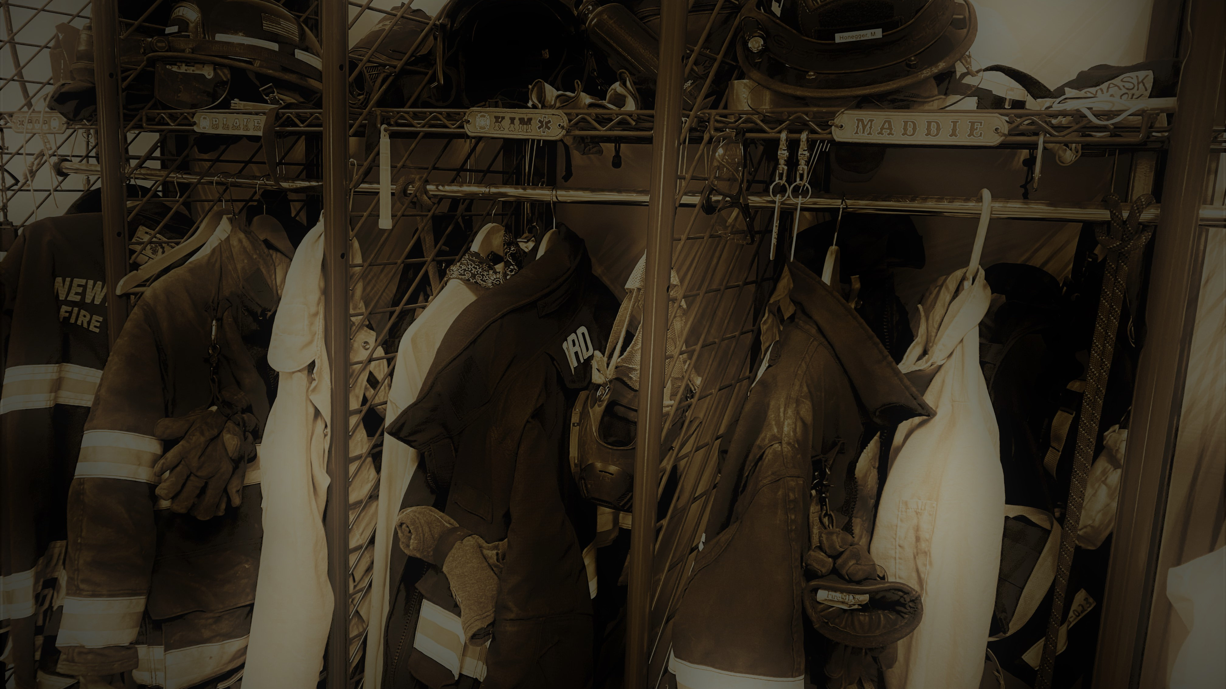
WHERE WE NOW
WHERE WE WILL BE IN 2027
WE ARE LOSING GROUND DUE TO:
INFLATION
LIMITED INCREASE IN LEVY AMOUNTS.
INCREASED OPERATIONAL COSTS

Slide 3
$240K
Increase in wages, personnel costs,
and Operating Costs
Increase has been covered by reserves but we will be in the RED in 2025

Slide 7
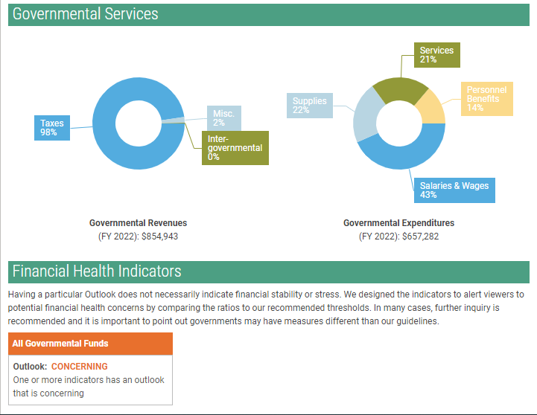
Personnel Benefits 14%
Supplies
22%
Misc.
2%

Slide 8
Personnel:
2013
1 Full Time Chief $80,000
2 Part Time Deputy Chiefs/Medical Officers $50,000
1 Part Time Finance Officer $20,000
Total Administrative Wages $150,000

Slide 9
2013
1 Full Time Chief $80,000
2 Part Time Deputy Chiefs/Medical Officers $50,000
1 Part Time Finance Officer $20,000
Total Administrative Wages $150,000
24 Community Volunteer Firefighter/Medical Volunteers
12 First Responders
8 EMT’s
4 AEMT’s
(8 Interior Firefighters)
2013 Total costs for Benefits, Volunteer costs, stipends, and taxes $83,000

Slide 10
2023
1 Full Time Chief $100,000
1 Part Time Finance Officer $42,000
1 full-time firefighter/Medical Officer $73,000
Total Administrative Wages $215,000 +$65K
.

Slide 11
2023
1 Full Time Chief $100,000
1 Part Time Finance Officer $42,000
1 full-time firefighter/Medical Officer $73,000
Total Administrative Wages $215,000 +$65K
18 Community Volunteers, Firefighter/Medical
6 EMT’s
1 AEMT’s
3 Paramedics
8 First Responders
(9 Interior Firefighters)
(2 Exterior Firefighters)
2023 Total costs for Benefits, Volunteer costs, stipends, and taxes $172,000 + $89K
18 Shift Volunteers, Firefighter/Medical
9 EMT’s
9 First Responders
(8 Recruits/ Exterior Firefighters)
(5 Interior Firefighters)
(7 Apparatus Operators)
1 Volunteer Maintenance Officer

Slide 12
Possible Cost Saving Cuts
Cuts Total
1. No Full-Time training and maintenance Captain
• Wage $73K, Benefits $24K $97K
2. No Administrative Assistant/EMT/Support FF
• Wage $48K, Benefits $17K $65K
3. No Shift Volunteers (No one working during the week/weekend)
• Administrative Volunteer Stipends $15K
• No shift stipends $16K $31K

Slide 13
Possible Operational Cost Saving Cuts
Cuts Total
4. No Uniforms $5K
5. No New, Replacement, or modified Firefighting Equipment $10K
6. No New, Replacement Firefighting Protective Clothing $12K
7. No Outside Classes for volunteers $8K
8. Close Down Station 2 and mothball old equipment $8K
9. Insurance savings $2K
TOTAL SAVINGS $238K

Slide 14
Possible Operational Cost Saving Cuts
Cuts Total
4. No Uniforms $5K
5. No New, Replacement, or modified Firefighting Equipment $10K
6. No New, Replacement Firefighting Protective Clothing $12K
7. No Outside Classes for volunteers $8K
8. Close Down Station 2 and mothball old equipment $8K
9. Insurance savings $2K
TOTAL SAVINGS $238K

Slide 15
Fire Dist. #13 will consist of:
• 1 Fire Chief working during the week
• 18 Community Volunteers not being supplemented with stipends for extra work.
• Only Station 1 is in operation with no staff other than the Chief.
• 1 – 2 Community Volunteers available during the weekday.

Slide 16
• No Station 2 and its equipment.
• Incomplete Training Program.
• Increased costs of apparatus and equipment maintenance and repairs.
• Limited Mutual Aid from SVFD
• No Auto-Aid from Spokane Valley or Kootenai County

Slide 17
Response will be delayed or there will be no emergency responders during certain times of the day.
• Compliance for Washington Standards and Rating Bureau will go down so the insurance rating will go up increasing insurance premiums.
• Ability to deal with unforeseen costs or equipment failure, or other ramifications.
Won’t be in compliance with Federal and State
mandates = higher chance for lawsuits and fines

Slide 18
No Levy Lid Lift but FD makes budget cuts =
$238K in cuts
• Budget will be balanced but there will be no reserves and no room for added inflationary increases.

Slide 19
QUESTIONS

